Slide 1



Intermediate
Programming
WEEK 5 – Regular Expressions (part 2)

Slide 2
Review
Regular Expressions
Common regex
Quantifier
Meta characters

Slide 3
What are regular expressions?
Regular expressions (regex) defines a search pattern for strings.
The search pattern can be anything from a simple character, a fixed string or a complex expression containing special characters describing the pattern. The pattern defined by the regex may match one or several times or not at all for a given string.
Regular expressions can be used to search, edit and manipulate text.

Slide 4
Where can I use regex?
Password checking and validation
Data preprocessing (e.g., natural language processing)
Search engines
Searching for files in your computer
Search and replace text in your editor (e.g., word)
User input validation in web applications
Parsing

Slide 5
How can we write regex?

Slide 6

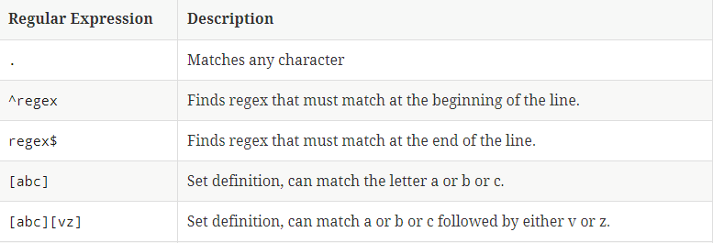
Common regular expressions

Slide 7
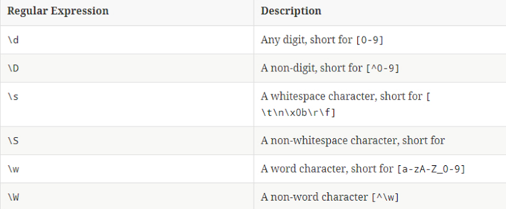
Meta characters
Meta characters have a pre-defined meaning and make common patterns easier to use.

Slide 8
NOTE:.
This meta-characters have the same first letter as their representation.
Example: digit => \d space => \s word => \w

Slide 9
Backslash in Java
In Java Strings, backslash (“\”) is an escape character. That means, backslash has a predefined meaning in Java. One should use double backslash to define a single backslash.
For example:
\w => \\w
\ => \\\\

Slide 10
Regex with String methods
Allows us to manipulate Strings
matches(“regex”)
Evaluates if "regex" matches s. Returns only true if the WHOLE string can be matched.
split(“regex”)
Creates an array with substrings of s divided at occurrence of "regex". "regex" is not included in the result.
replaceFirst(“regex”),”replacement”
Replaces first occurrence of "regex" with"replacement.
replaceAll(“regex”),”replacement”
Replaces all occurrences of "regex" with"replacement.

Slide 11
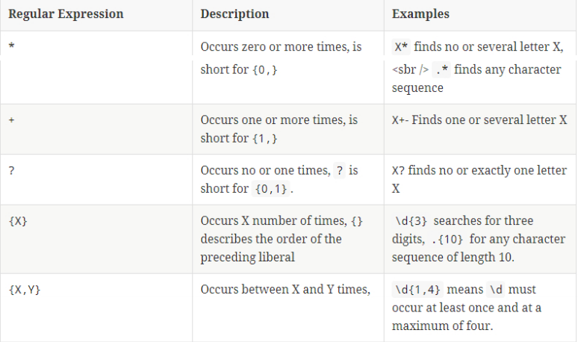
Quantifiers
A quantifier defines how often an element occur

Slide 12
EXERCISE

Slide 13
Programming Exercise
Write a regular expression to match a valid phone number in the format (xxx) xxx-xxxx.
Write a regular expression to match a date in the format mm/dd/yyyy.
Write a regular expression to match a string that contains only letters and digits.

Slide 14
Outline
Grouping
Back referencing
Pattern and Matcher class

Slide 15
Grouping and back referencing
You can group parts of your regular expression using round brackets ( ). This allows you to assign a repetition operator to the complete group.
For example:
String pattern = “([A-Z] [a-z]* \\s [a-z]*)+”;
These groups also create a back reference to the part of the regular expression.
A backreference stores a part of a string that matches a group. You can refer to the group using $
For example:
String pattern = “(\\w)(\\s)(\\d)”;
System.out.println(text.replaceFirst(pattern,$1$2));

Slide 16
DEMO

Slide 17
Negative look-ahead
Negative look ahead provides the possibility to exclude a pattern. With this you can say that a string should not be followed by another string.
Negative look ahead are defined via (?!pattern).
Example:
String pattern = “([a-z](?!\\d))*”;

Slide 18
Positive look-ahead
Positive look ahead provides ensures that a pattern is included. With this you can say that a string should be followed by another string.
Positive look ahead are defined via (?=pattern).
Example:
String pattern = “([a-z](?=\\d))+”;

Slide 19
DEMO

Slide 20
Specifying modes inside the regex
(?c) makes the regex case sensitive
(?i) makes the regex case insensitive.

Slide 21
Pattern and Matcher
For advanced regular expressions the java.util.regex.Pattern and java.util.regex.Matcher classes are used.
You first create a Pattern object which defines the regular expression. This Pattern object allows you to create a Matcher object for a given string. This Matcher object then allows you to do regex operations on a String.

Slide 22
SAMPLE PROGRAM

Slide 23
Laboratory Activity #2
Use the code template (regex_activity.java) uploaded in the Github repository – CCPRGG2L to create a program with 3 methods. The first method checks if a username is valid. The second method checks if the email is valid and the third method checks if there is a panda word in the string.
Kindly see the comments inside the code template for the requirements for each method. Input files are provided in the input_files folder in Github.

Slide 24
Intermediate
Programming
WEEK 5 – Regular Expressions (part 2)

